Slide 1


AstroSage Analysis
Vikas Upadhyay
12/09/2024

Slide 2
Problem Statement
You are tasked with optimizing the call center operations for AstroSage, which has received a 1 crore investment. The goal is to determine how to allocate this investment to maximize operational efficiency, customer satisfaction, and profitability. This project will involve analyzing historical call data, performance metrics, and market trends to make informed decisions.

Slide 3
Introduction and Objectives
AstroSage, a leading astrology platform, handles high volumes of customer interactions daily. To ensure long-term success, the project focuses on improving operational efficiency, customer satisfaction, and profitability.
Key Focus Areas:
Operational Efficiency:
Improve First Call Resolution
Enhance agent utilization
Customer Satisfaction:
Boost Customer Satisfaction
Address key service gaps
Profitability:
Implement cost-saving measures via technology upgrades, agent training, and workforce management.

Slide 4
AstroSage Data Overview
Call Data Breakdown:
Total Call Volume: Daily, weekly, and monthly trends.
Peak Call Hours: Identify busiest times.
Call Duration: Average call length over time.
Average Handle Time: Time agents spend per call.
Agent Utilization: Active vs. idle time.
Customer Satisfaction:
CSAT: Ratings from post-call surveys.
Feedback Themes: Key issues and satisfaction drivers.
Data Cleaning:
Remove Duplicates: Eliminate redundant logs.
Handle Missing Values: Address gaps in data.
Outlier Detection: Manage extreme call times and feedback scores.

Slide 5
Analytical Approach and tools
Data Cleaning: Utilized functions like TRIM, CLEAN, and Remove Duplicates to ensure data accuracy.
Descriptive Analysis: Employed PivotTables for summarizing key metrics.
Data Enrichment: Enhanced the dataset with adding additional columns.
Customer Segmentation: Applied SORT and FILTER functions to classify customers based on Ratings and Calls.
Visualization: Created dynamic charts and dashboards for data representation, enabling interactive data exploration.

Slide 6
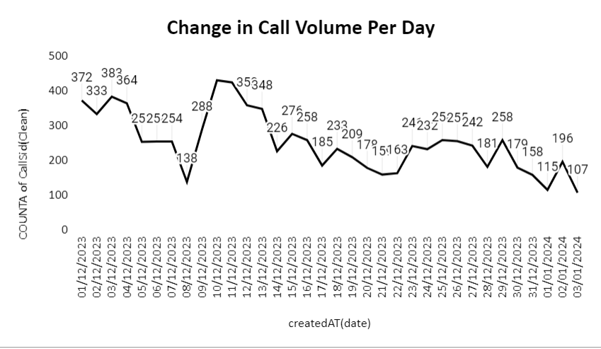
Call Volume Analysis
Purpose: Understanding daily call volume trends helps in resource planning by identifying busy periods and adjusting staffing levels.
Insights:
Busy Periods: Peak activity mid-December and holiday season.
Call Duration Drop: Lower interaction near the end of the month due to holidays.
Actionable Takeaway: Adjust resources by increasing agents during peak times and scaling back during slower periods.

Slide 7
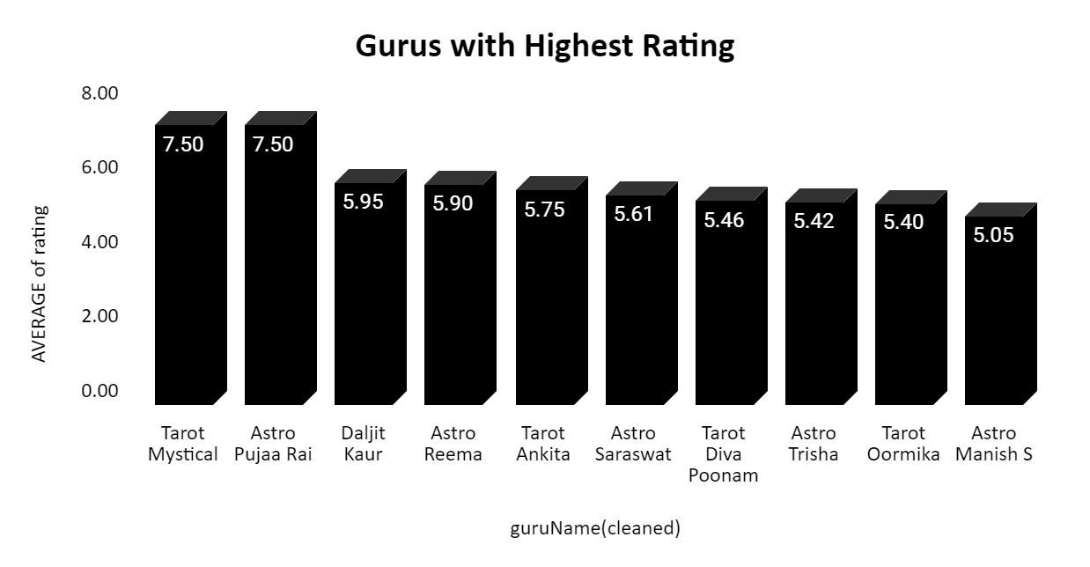
Agent Performance Analysis
Top Gurus: High ratings indicate strong performance and customer satisfaction.
Gradual Decline: Many gurus have average ratings, with performance varying widely.
Lowest Ratings: Sharp drop in ratings for some, indicating service quality or training issues.
Implication:
A large performance gap exists, suggesting a need for targeted training and performance reviews to improve consistency.

Slide 8
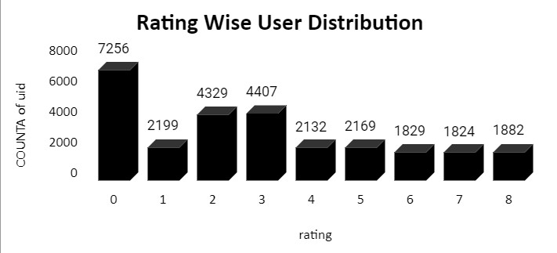
Customer Satisfaction Analysis
Majority of users (7,256) gave a rating of 0, indicating potential dissatisfaction.
Ratings of 2 and 3 have relatively high counts (4,300+ each).
The high volume of low ratings suggests underlying issues that warrant further investigation.
Ratings between 4 and 8 are more balanced, with user counts ranging from 1,800 to 2,100.

Slide 9
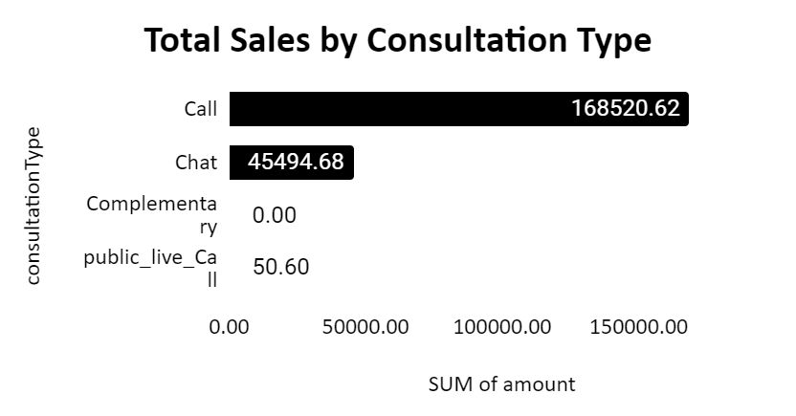
Total Sales by Consultation Type Analysis
Calls dominate with the highest "SUM of amount" (168,520.62).
Chats account for a smaller portion (45,494.68).
Public live calls have minimal value (50.60), almost negligible.
Calls are overwhelmingly the most significant category.

Slide 10
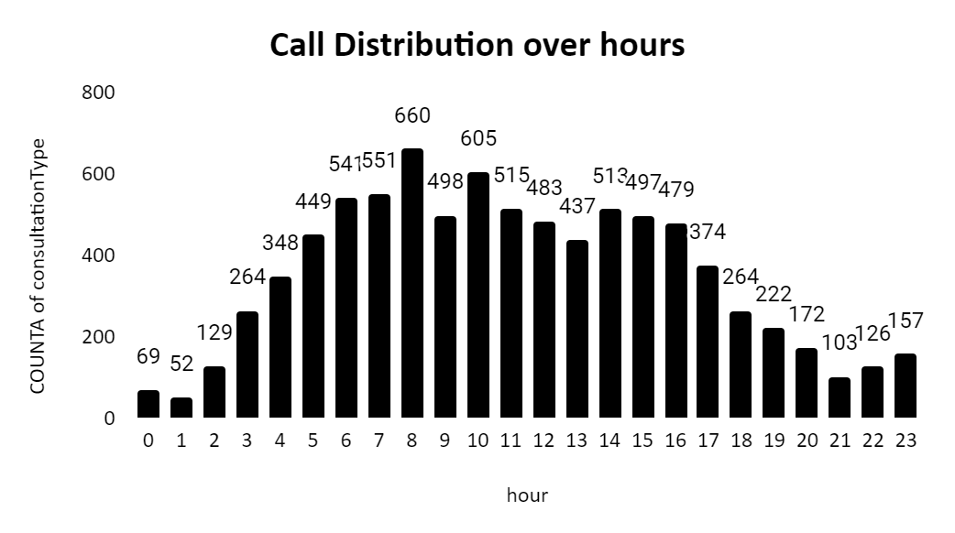
Call Distribution Over Hours Analysis
Peak call volume occurs between 6 to 11 AM.
More agents are needed during peak hours to manage workload efficiently.
Reduce manpower during low call volume periods.
Goal is to distribute work evenly throughout the day.

Slide 11
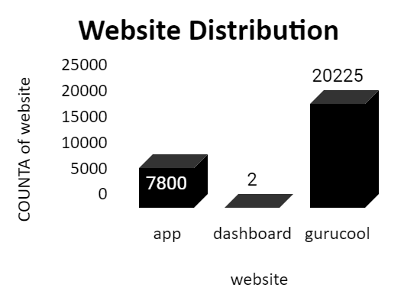
Website Distribution Analysis
Gurucool has the highest count with 20,225 users.
App follows with 7,800 users.
Dashboard has an extremely low count with only 2 users.
Gurucool is the most visited platform, while Dashboard shows minimal engagement.

Slide 12
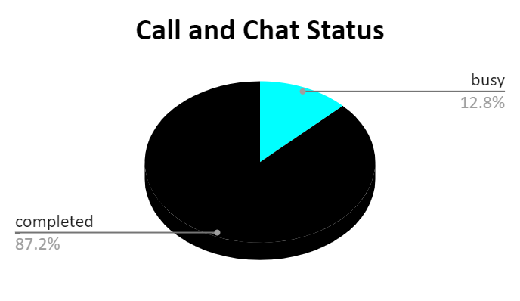
Call and Chat Status Analysis
87.2% of calls and chats are completed.
12.8% of calls and chats are marked as busy.
Majority of interactions are successfully completed, with a small portion encountering busy signals.

Slide 13
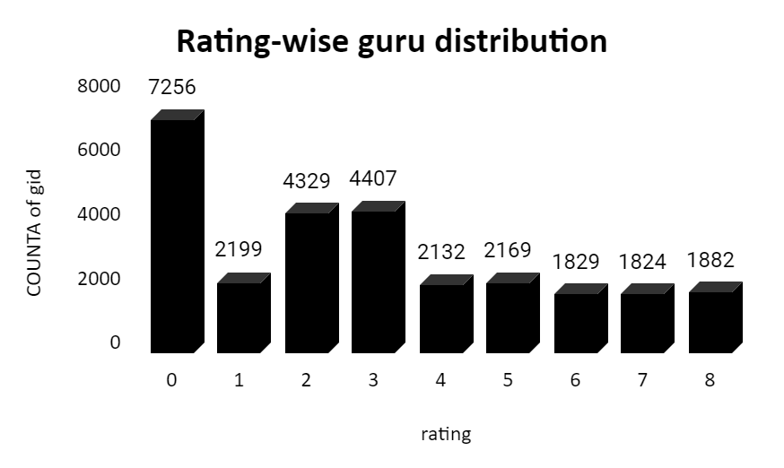
Guru Distribution Analysis
Majority of users (7,256) gave a rating of 0, indicating potential dissatisfaction.
Ratings of 2 and 3 are also high, with 4,329 and 4,407 users, respectively.
The high volume of low ratings suggests underlying issues that warrant further investigation.
Ratings between 4 and 8 are more balanced, with counts ranging from 1,800 to 2,100.
The chart suggests a large portion of users are unhappy, with lower ratings dominating.

Slide 14
Insights from Data Trends
Call volume insights:
Peak Periods
Agent Performance Insights:
Agent Utilization
Average Handle Time Agent Turnover
Customer Satisfaction Insights:
Agent Engagement
Feedback Themes

Slide 15
Subjective Feedback Analysis
Balanced Investment Allocation:
Technology Upgrades
Agent Training
Hiring
Performance Comparisons (AstroSage vs. AstroGuru):
Compare call volume and agent performance with AstroGuru to identify process improvements for handling peak times and boosting satisfaction.
Handling Peak Call Periods:
Real-Time Dashboards
Improved Scheduling

Slide 16
Subjective Feedback Analysis
Workload Balancing:
Data-Driven Schedules
Agent Specialization
Strategic Recommendations for Overall Efficiency:
Cross-TrainingCustomer Satisfaction Factors:
Continuous Monitoring
Key Recommendations:
Focus on continuous training and feedback loops for agents to enhance skills and retain top performers.
Use real-time data to balance workloads, ensure operational efficiency, and improve decision-making.

Slide 17
Strategic Recommendation
Workforce Optimization
Smart Scheduling
Rotating Shifts
Performance-Based Incentives
Customer-Centric Approach
Improve Customer Feedback Mechanism
Enhanced Self-Service Options
Cost Optimization
Outsource Non-Essential Tasks
Monitor and Reduce Operational Costs

Slide 18
Recommended Technology Investments
Implement AI-Powered Chatbots
Upgrade CRM Systems
Call Monitoring & Analytics Tools
IVR System Enhancement
Cloud-based Telephony

Slide 19
Training and Development Initiatives
Continuous Skill Development
Technology Training
Soft Skills Enhancement
Cross-Training
Performance Feedback Loops

Slide 20
Infrastructure Enhancements
Upgrade Workstations
Ergonomic Office Setup
High-Speed Internet & Redundancy
Enhanced Security Systems
Break Rooms & Wellness Spaces

Slide 21
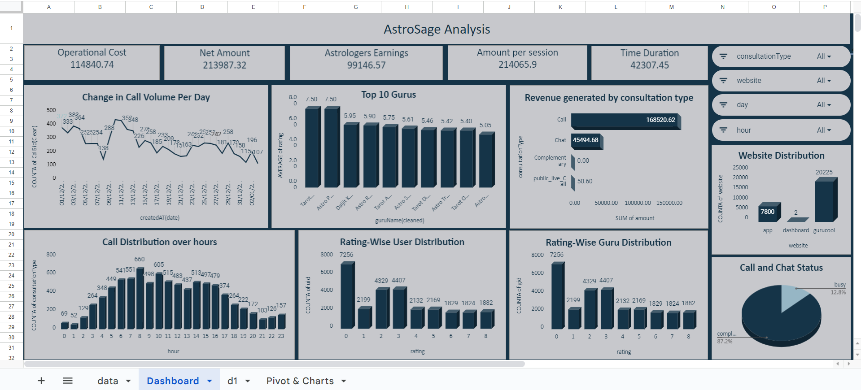
Dashboard and Visualizations

Slide 22
Conclusion
Technology Upgrades
Employee Training
Customer-Centric Approach
Workforce Optimization
Cost Management

